Slide 1


Record Audio And Breakpoint Upload Solutions
By Richard Jiang
The future is present -----Mobile Team

Slide 2

General
What is the format should we use for audio?
How to implement the upload the audio file?
How to play the audio file?
How to integrate with the Hybird solutions?

Slide 3

Record Audio

Slide 4
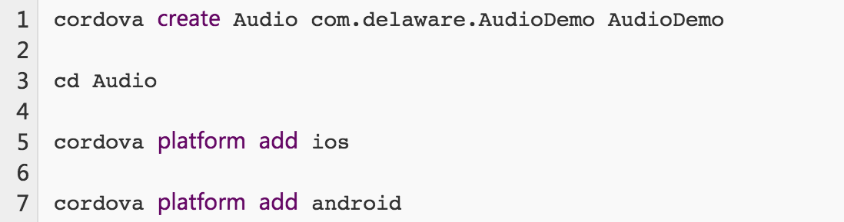
Create Cordova Project

Slide 5

Audio Format
The Latest compression method standardized.
To create multimedia objects possessing better abilities of adaptability and flexbility.
It is the most popular format in the multi-media.
The extension name is .m4a

Slide 6
Install Hybird Plugin
Record audio by m4a and compress it.
Stop and Play the record file(eg. m4a)
Install it by follow command:

Slide 7
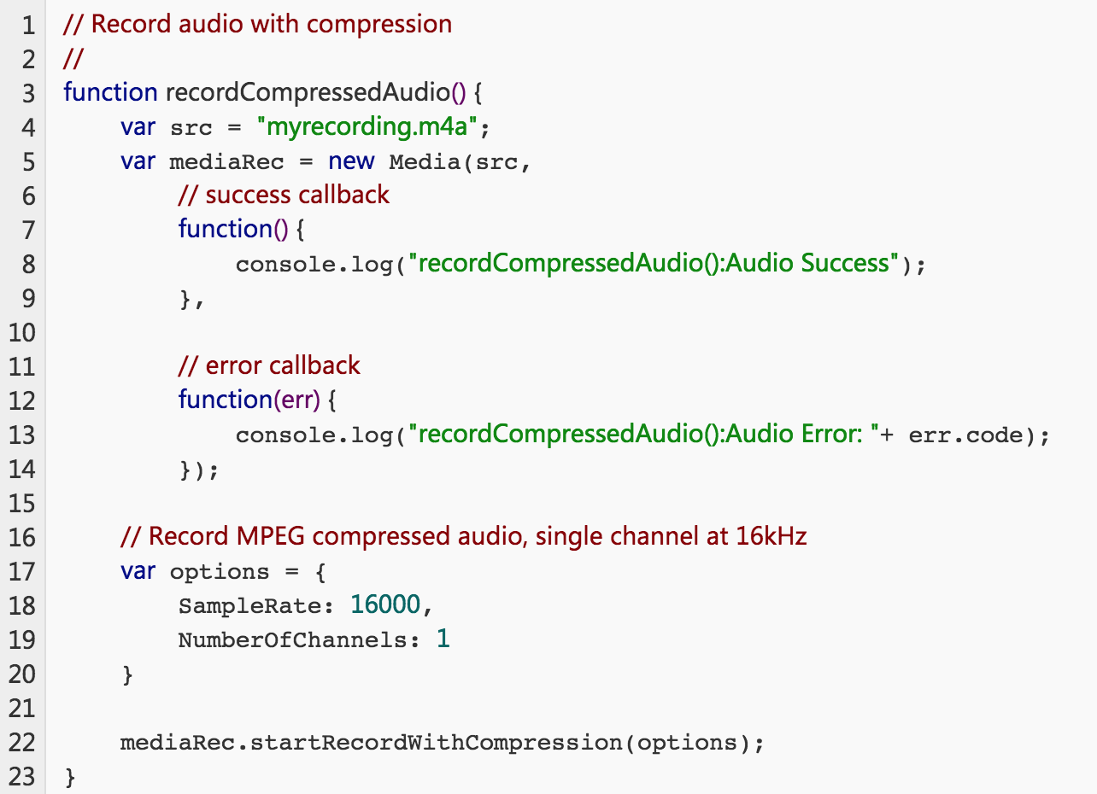
Record the audio file with m4a

Slide 8
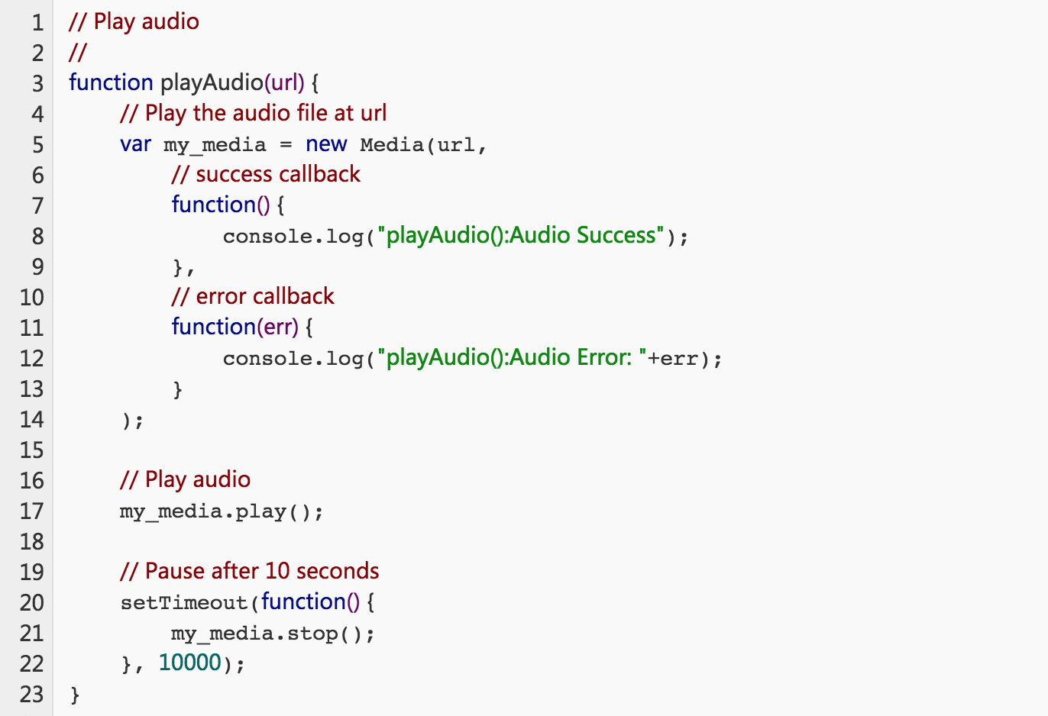

Stop And play the Audio File

Slide 9
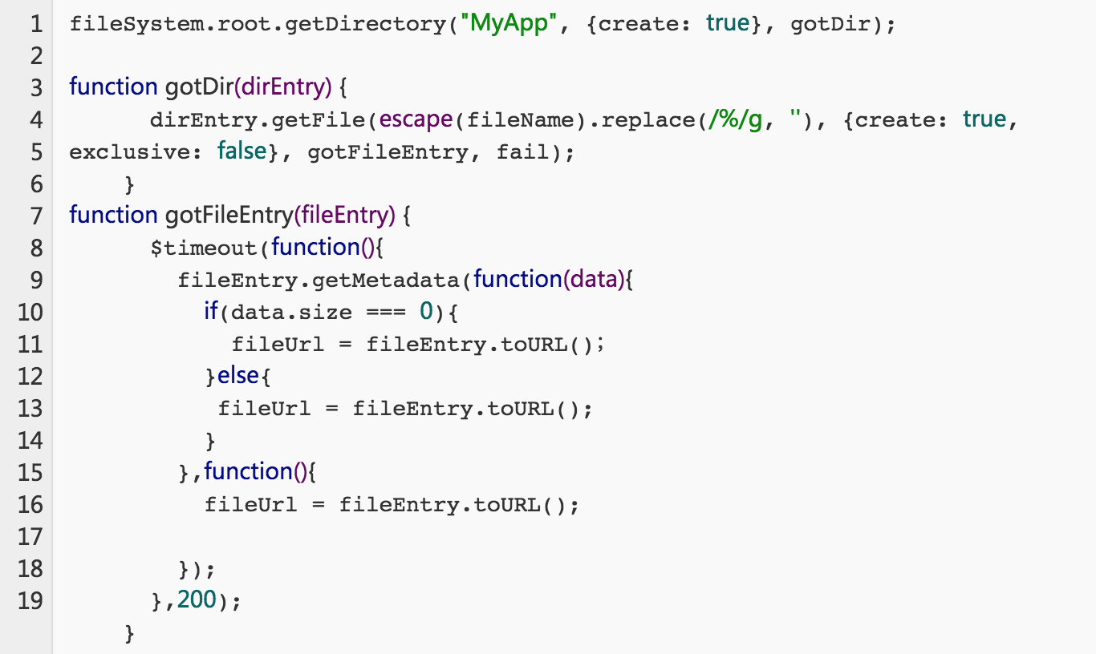
Manage the Audio File position

Slide 10

Socket protocol
Transfer by byte data and custom data, reduce the cost.
Spend short time for transmission, high performance.
Better for C/S structure.
Difficult to implement it.

Slide 11
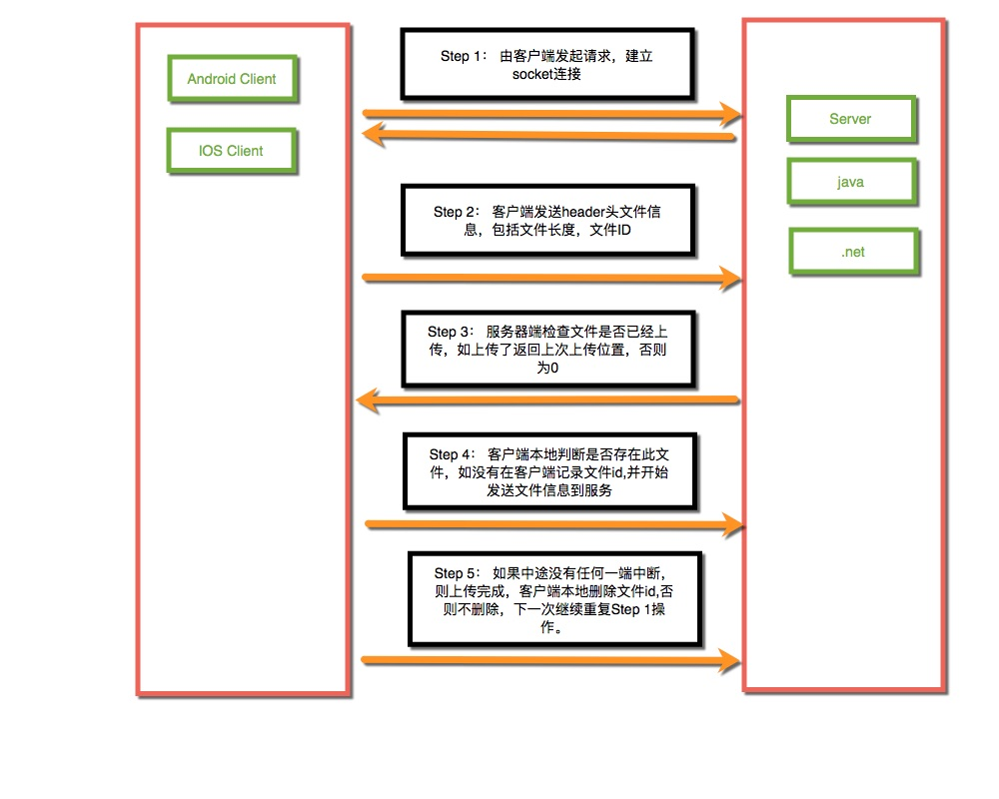

Android Break upload Solutions.

Slide 12

Android Simple Code
See demo code!

Slide 13
Check Last upload progress
See demo code!

Slide 14
Update the upload progress
See demo code!

Slide 15


